Slide 1
BBM-382 – SOFTWARE ENGINEERING
SPRING 2018
Lecture 3
Asst.Prof.Dr. Ayça TARHAN

Slide 2
CHAPTER 4 – REQUIREMENTS ENGINEERING

Slide 3
Contents
Functional and non-functional requirements
The software requirements document
Requirements specification
Requirements engineering processes
Requirements elicitation and analysis
Requirements validation
Requirements management

Slide 4
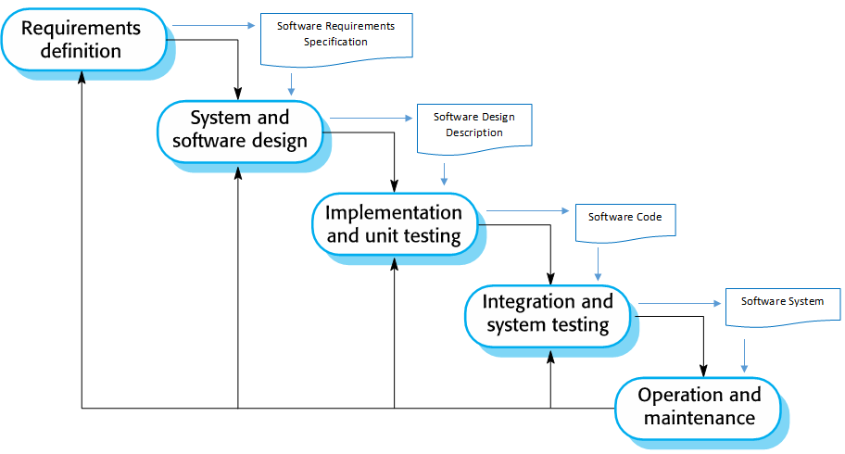
Waterfall Development Model - Revisited

Slide 5
Challenges - Revisited
Characteristics of software:
Intangible (abstract)
Changeable
Characteristics of software development:
Human-intensive
Multi-disciplinary
Business Domain
Technical Domain

Slide 6





Business Domains and Requirements
Tourism
Education
Development Team:
WHAT TO DEVELOP?
What are customer needs?
How will software behave
to satisfy these needs?
Shopping

Slide 7

Requirements
The knowledge of entire
business domain
Requirements are the most critical aspect of the software development cycle.
Studies point to a more than 60% failure rate for software projects in the U.S., with poor requirements as one of the top five reasons.
Studies also show a high percentage of project schedule overruns, with 80% due to creeping requirements.
The part that we
could see at the start
Managing requirements must be an integral part of an organization’s overall development process, and is vital to mitigating risk of cost overruns and delays on large development projects.

Slide 8
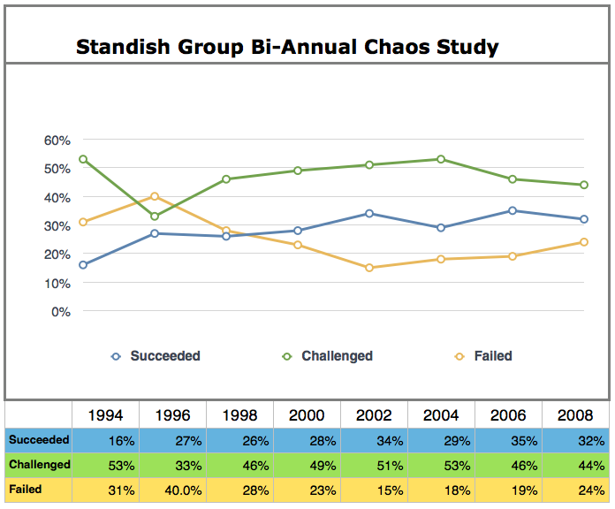
Standish Group Bi-Annual Chaos Study
http://flowchainsensei.wordpress.com/2013/10/14/a-new-frame/
Notes:
http://flowchainsensei.wordpress.com/2013/10/14/a-new-frame/

Slide 9
Requirements engineering
Requirements Engineering is:
the process of establishing the services that the customer requires from a system, and
the constraints under which it operates and is developed.
The requirements themselves are:
the descriptions of the system services and constraints that are generated during the requirements engineering process.

Slide 10
What is a requirement?
It may range from:
a high-level abstract statement of a service or of a system constraint
to:
a detailed specification, e.g., of a mathematical function
This is inevitable as requirements may serve a dual function
the basis for a bid for a contract - therefore must be open to interpretation;
contract itself - therefore must be defined in detail;
Both statements may be called requirements.

Slide 11
A spiral view of the requirements engineering process

Slide 12
Stages (Levels) of requirements
User requirements
Statements in natural language plus diagrams of the services the system provides and its operational constraints.
Written for customers.
System requirements
A structured and detailed descriptions of the system’s functions, services and operational constraints.
Defines what should be implemented so may be part of a contract between client and contractor.
Written for systems and software developers.
Typically, a user requirement is detailed into more than one system requirements.

Slide 13
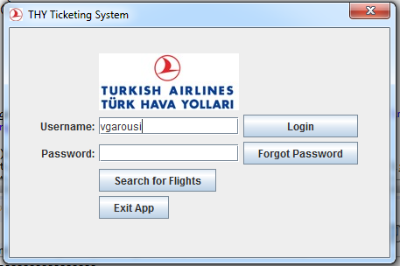
Example: Flight Booking System (FBS)
Scope of Development:
A Flight Booking System (FBS) that serves different functionalities for reservation agents and reservation managers shall be designed and developed.

Slide 14
Example: FBS – User Requirements
User requirement
(1) A reservation manager shall be able to manipulate flights (enter new ones, update existing flight information, delete flights, etc.), and generate inventory reports of flights.
System requirements
(1.1) A reservation manager should be able to manipulate flights (enter new ones, update existing flight information, delete flights, etc.), and generate inventory reports of flights. The inventory report should contain a summary of all fights in the system that still have unsold seats (either economy or economy), and the total number of unsold seats of business class and economy class in all flights.
(1.2) Flight information (to be manipulated by reservation managers) should include the following: airline code (e.g., AC), flight number (e.g.., 321), departure airport, departure terminal number, departure date and time, arrival airport, arrival terminal number, arrival date and time, cost of business class and cost of economy class ticket.
(1.3) The flight number is a 3-digit number, prefixed with 0’s if less the actual number is less than 100.
(1.4) The airline code must be a two-letter code defined in http://en.wikipedia.org/wiki/IATA_airline_designator .
(1.5) The airport location must be one of airport with a three-letter code defined in http://en.wikipedia.org/wiki/List_of_airports_by_IATA_code.

Slide 15
Types of Requirements
Functional requirements
Statements of services the system should provide, how the system should react to particular inputs and how the system should behave in particular situations.
May also state what the system should not do.
Non-functional requirements
Constraints on the services or functions offered by the system such as timing constraints, constraints on the development process, standards, etc.
Often apply to the system as a whole rather than individual features or services.

Slide 16
Example: FBS – Functional and Non-functional requirements
Functional requirement:
A reservation manager shall be able to log into the system with his/her username and password.
Non-functional requirements:
The system shall enable log in of its users within 5 sec
Performance requirement
The system shall enable secure log in of its users.
Security requirement
Software
Behavior
Constraints
on
Software
Behavior

Slide 17
Example: FBS – Usability (non-functional) requirement
User need:
The system shall be easy to use by flight booking staff and shall be organized in such a way that user errors are minimized.
Verifiable non-functional requirement:
Flight booking staff shall be able to use all the system functions after six hours of training. After this training, the average number of errors made by experienced users shall not exceed two per hour of system use.

Slide 18

In-class exercise
Write performance non-functional requirements for the FBS under these items:
User need
Verifiable non-functional requirement
Time: 5 minutes

Slide 19
Types of Requirements (cont’d)
Domain requirements
Constraints on the system from its operational domain
If not satisfied, the system may be unworkable
Requirements are expressed in the language of the application domain, and this is often not understood by engineers developing the system.
Domain specialists understand the area so well that they do not think of making the domain requirements explicit.
Process requirements
Requirements that are specified mandating a particular IDE, programming language, development method or standard.

Slide 20
Example: FBS – Domain and Process requirements
Domain requirement:
When there is a natural disaster (e.g. strong storm or tornado) on a specific location and date as reported by Weather Monitoring System, all flights that depart from/arrive to that location on that date will be cancelled.
Process requirements:
The system shall be developed by following Waterfall Development Model.
The system shall be a simple client-server, web-based application.
The system shall be developed with Java.

Slide 21
Specification of Requirements
Requirements should be :
Unambigious:
They should not be interpreted in different ways by developers and users.
Complete:
They should include descriptions of all facilities required.
Consistent:
There should be no conflicts or contradictions in the descriptions of the system facilities.

Slide 22
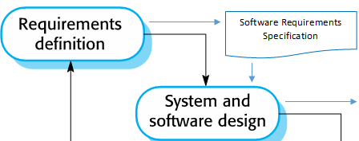
The software requirements document
The software requirements document is the official statement of what is required of the system developers.
Should include both
a definition of user requirements, and
a specification of the system requirements.
It is NOT a design document. As far as possible, it should set of WHAT the system should do rather than HOW it should do it.

Slide 23
Users of a requirements document

Slide 24
Requirements document variability
Information in requirements document depends on type of system and the approach to development used, e.g.
A systems developed by Waterfall Model are required to have all details in its requirements document.
A system developed incrementally (e.g. by iterations) will typically have less detail in its requirements document.
Requirements documents standards have been designed, e.g. IEEE standard 830.
These are mostly applicable to the requirements for large systems engineering projects.

Slide 25
Requirements engineering (RE) process
The processes used for RE vary widely depending on the application domain, the people involved and the organization developing the requirements.
However, there are a number of generic activities common to all processes:
Requirements elicitation and analysis;
Requirements specification;
Requirements validation;
Requirements management.
In practice, RE is an iterative activity in which these processes are interleaved.

Slide 26
In-class exercise
Discuss with your friend and write down how you will conduct these for the FBS:
Requirements elicitation and analysis
Requirements specification
Requirements validation
Requirements management
Time: 5 minutes

Slide 27
A spiral view of the requirements engineering process - revisited

Slide 28
1) Requirements elicitation and analysis
Technical staff works with customers to find out about:
the application domain,
the services that the system should provide, and
the system’s operational constraints.
May involve end-users, managers, domain experts, engineers, trade unions, etc.
These are called stakeholders.
Starts with requirement discovery

Slide 29
Requirements discovery
It is the process of:
Gathering information about the required and existing systems, and
Distilling the user and system requirements from this information.
Requires interaction with system stakeholders from managers to external regulators.
Business Domain
Business requirements are discovered
User requirements are elicited and specified
System requirements are derived and specified
Technical (Solution) Domain

Slide 30
Problems of requirements elicitation and analysis
Stakeholders don’t know what they really want.
Stakeholders express requirements in their own terms.
Different stakeholders may have conflicting requirements.
Organisational and political factors may influence the system requirements.
The requirements change during the analysis process. New stakeholders may emerge and the business environment may change.

Slide 31
System context
From an early stage of system specification, we should decide on the boundaries of the system under development, e.g.:
What functionality will be included in the system,
What is provided (e.g. inputs) by the system’s environment,
Manual versus automated functionality of business processes.
We can use a context model to represent this information (see Chapter 5).
Boundary of
system development

Slide 32
Example: FBS – Context model
Scope of
system development
Context of system development

Slide 33
A spiral view of the requirements engineering process

Slide 34
2) Requirements specification
Requirements specification is the process of writing the user and system requirements in a requirements document.
User requirements have to be understandable by end-users and customers who do not have a technical background.
System requirements are more detailed requirements and may include more technical information.
The requirements may be part of a contract for the system development
It is therefore important that these are as complete as possible.

Slide 35
Ways of writing a system requirements specification
Notation | Description
Natural language | The requirements are written using numbered sentences in natural language. Each sentence should express one requirement.
Structured natural language | The requirements are written in natural language on a standard form or template. Each field provides information about an aspect of requirement.
Design description languages | This approach uses a language like a programming language, but with more abstract features to specify requirements by defining an operational model of system. This approach is now rarely used although it can be useful for interface specifications.
Graphical notations | Graphical models, supplemented by text annotations, are used to define functional requirements for system; UML use case and sequence diagrams are commonly used.
Mathematical specifications | These notations are based on mathematical concepts such as finite-state machines or sets. Although these unambiguous specifications can reduce the ambiguity in a requirements document, most customers don’t understand a formal specification. They cannot check that it represents what they want and are reluctant to accept it as a system contract

Slide 36
Guidelines for writing requirements
Invent a standard format and use it for all requirements.
Use language in a consistent way.
Use shall for mandatory requirements, should for desirable requirements, an may for optional requirements.
Use text highlighting to identify key parts of the requirement.
Avoid the use of computer jargon.
Include an explanation (rationale) of why a requirement is necessary.

Slide 37
Example: FBS requirements – Natural Language
A reservation manager shall be able to use the system to create accounts for reservation agents.
The system shall enable a reservation manager to log in with his/her username and password.
The reservation manager shall be able to manipulate flights (enter new ones, update existing flight information, delete flights, etc.), and generate inventory reports of flights.
When a flight is canceled by the reservation manager, all itineraries that are reserved or booked and include that flight shall be canceled as well.
The reservation manager shall be able to view information of a reservation agent and confirm a ticket for him/her.
The reservation manager shall be able to log out at any stage during his/her session.

Slide 38
Example: FBS requirements – Structured Natural Language (e.g. Tabular structure)
Use case: Login
Actors | Traveler
Precondition | Traveler is not logged in
Post-condition | Traveler is logged in
Main (happy) path: | User enters her/his username and password and presses on the Login button System checks the username and password and shows the app’s main window (page) User will be able to use the feature afterwards
Alternative path: | If the username and password combination is invalid, the system will show a message indicating it User will be able to enter another username and password
- Interaction between user(s) and the software system to be developed!
- Only outside behavior of the systems as observed by the user(s)!

Slide 39
In-class exercise
Write the structured tabular requirements for the feature “Search for Flights”
Time: 5 minutes
Use case: Login
Actors | Traveler
Precondition | Traveler is not logged in
Post-condition | Traveler is logged in
Main (happy) path: | User enters her/his username and password and presses on the Login button System checks the username and password and shows the app’s main window (page) User will be able to use the feature afterwards
Alternative path: | If the username and password combination is invalid, the system will show a message indicating it User will be able to enter another username and password

Slide 40
Scenarios (or user stories)
Scenarios are real-life examples of how a system can be used.
They should include
A description of the starting situation;
A description of the normal flow of events;
A description of what can go wrong;
Information about other concurrent activities;
A description of the state when the scenario finishes.

Slide 41
Example: FBS Scenarios (in Natural Language)
Scenario: Search for flights & create reservation
When a reservation agent wants to create and book a travel itinerary, he/she first shall search for flight information. A list of available flight options shall be shown with departure/arrival and cost information. Once the agent selected an itinerary from the list, he/she shall have the option to reserve it.
Scenario: Buy a ticket
Once the reservation agent reserved an itinerary, he/she shall have the option to book it by providing payment information via credit card. If the credit card information is not on-file for the agent, he/she shall be prompted to enter the credit card information. Once the credit card is validated, the reservation agent shall be shown with the actual ticket information.

Slide 42
Ways of writing a system requirements specification
Notation | Description
Natural language | The requirements are written using numbered sentences in natural language. Each sentence should express one requirement.
Structured natural language | The requirements are written in natural language on a standard form or template. Each field provides information about an aspect of requirement.
Design description languages | This approach uses a language like a programming language, but with more abstract features to specify requirements by defining an operational model of system. This approach is now rarely used although it can be useful for interface specifications.
Graphical notations | Graphical models, supplemented by text annotations, are used to define functional requirements for system; UML use case and sequence diagrams are commonly used.
Mathematical specifications | These notations are based on mathematical concepts such as finite-state machines or sets. Although these unambiguous specifications can reduce the ambiguity in a requirements document, most customers don’t understand a formal specification. They cannot check that it represents what they want and are reluctant to accept it as a system contract

Slide 43
Scope of FBS Requirements by Use-Case Diagram

Slide 44
Use cases
Use-cases are a scenario based technique in UML (Unified Modeling Language), which identify actors in an interaction and describe externally observable interaction between the system and its actors.
A set of use cases should describe all possible interactions with the system (e.g. Use-case diagram).
High-level graphical model supplemented by more detailed tabular description (see Chapter 5).
Activity diagrams or sequence diagrams may be used to add detail to use-cases by showing the sequence of event processing in the system (see Chapter 5).

Slide 45
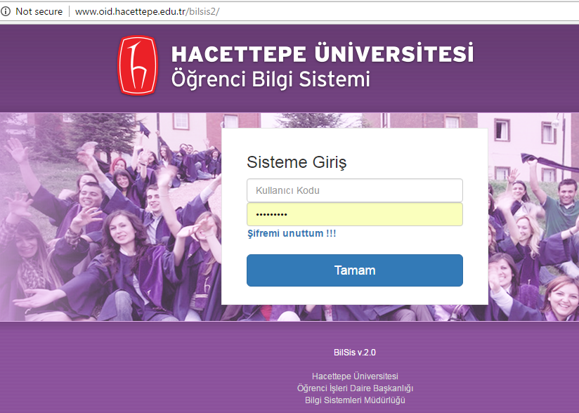
Exercise for HOME
System: student registration management system (like BILSIS2)
Draw the use-case diagram

Slide 46
Example: FBS – Details of "Search for Flights" use-case description by Activity Diagram

Slide 47
Example: FBS – Details of "Buy a Ticket" use-case description by Activity Diagram

Slide 48
A spiral view of the requirements engineering process

Slide 49
3) Requirements validation
Concerned with demonstrating that the requirements define the system that the customer really wants.
Requirements error costs are high so validation is very important.
Fixing a requirements error after delivery may cost up to 100 times the cost of fixing an implementation error.

Slide 50
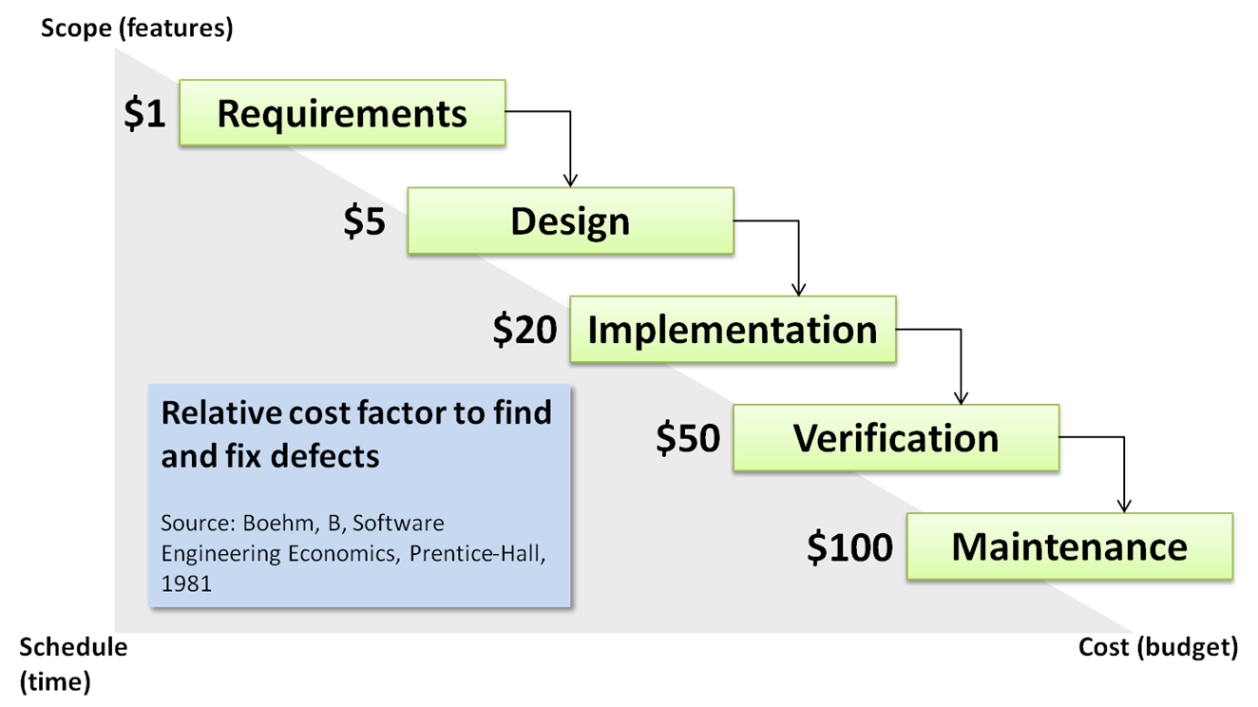
Relative cost factor to find and fix defects
http://www.softwareresults.us/2013/08/how-we-box-ourselves-in-with-software.html
Notes:
http://www.softwareresults.us/2013/08/how-we-box-ourselves-in-with-software.html

Slide 51
Checklist for requirements validation
Validity. Does the system provide the functions which best support the customer’s needs?
Consistency. Are there any requirements conflicts?
Completeness. Are all functions required by the customer included?
Realism. Can the requirements be implemented given available budget and technology?
Verifiability. Can the requirements be verified (e.g. tested)?

Slide 52
Requirements validation techniques
Requirements review
Systematic manual analysis of the requirements.
Prototyping
Using an executable model of the system to check requirements (see Chapter 2).
Test-case generation
Developing tests for requirements to check testability.

Slide 53
Requirements review
Regular reviews should be held while the requirements definition is being formulated.
Both client and contractor staff should be involved in reviews.
Reviews may be formal (with completed documents) or informal.
Good communications between developers, customers and users can resolve problems at an early stage.

Slide 54
Checklist for requirements review
Verifiability
Is the requirement realistically testable?
Comprehensibility
Is the requirement properly understood?
Traceability
Is the origin of the requirement clearly stated?
Adaptability
Can the requirement be changed without a large impact on other requirements?

Slide 55
4) Requirements management
Requirements management is the process of managing changing requirements during the requirements engineering process and system development.
New requirements emerge as a system is being developed and after it has gone into use.
We keep track of individual requirements and maintain links between dependent requirements so that you can assess the impact of requirements changes.
We establish a formal process for making change proposals and linking these to system requirements.

Slide 56
Requirements evolution

Slide 57
Changing requirements
The business and technical environment of the system always changes after installation.
New hardware may be introduced, it may be necessary to interface the system with other systems, business priorities may change and new legislation and regulations may be introduced that the system must necessarily abide by.
The people who pay for a system and the users of that system are rarely the same people.
System customers impose requirements due to organizational and budgetary constraints. These may conflict with end-user requirements and, after delivery, new features may have to be added for user support if the system is to meet its goals.

Slide 58
Changing requirements
Large systems usually have a diverse user community, with many users having different requirements and priorities that may be conflicting or contradictory.
The final system requirements are inevitably a compromise between them and, with experience, it is often discovered that the balance of support given to different users has to be changed.

Slide 59
Requirements change management

Slide 60
Requirements change management
Problem analysis and change specification
During this stage, the problem or the change proposal is analyzed to check that it is valid. This analysis is fed back to change requestor who may respond with a more specific requirements change proposal, or decide to withdraw the request.
Change analysis and costing
The effect of the proposed change is assessed using traceability information and general knowledge of the system requirements. Once this analysis is completed, a decision is made whether or not to proceed with the requirements change.
Change implementation
Requirements document and, where necessary, system design and implementation, are modified. Ideally, the document should be organized so that changes can be easily implemented.

Slide 61
Traceability of Requirements to Requirements
D: “dependent”
R: “relational”

Slide 62
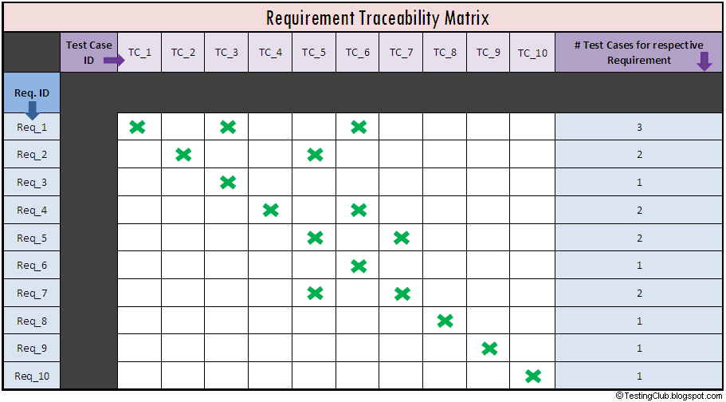
Traceability of Requirements to Test Cases

Slide 63
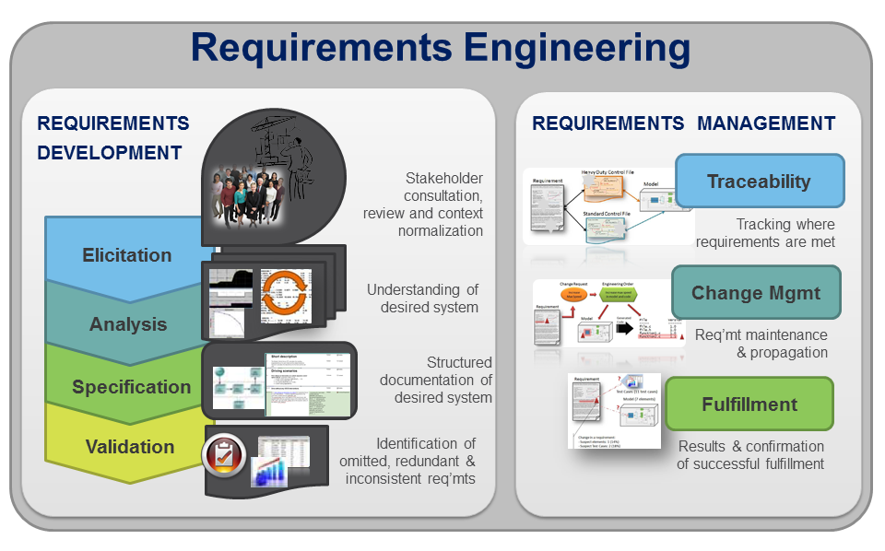
Requirements Engineering – Wrap up
http://www.mks.com/solutions/discipline/rm/requirements-engineering

Slide 64
For student reading…

Slide 65
Key points
Requirements engineering process is an iterative process including requirements elicitation, specification and validation.
Requirements elicitation and analysis is an iterative process that can be represented as a spiral of activities – requirements discovery, requirements classification and organization, requirements negotiation and requirements documentation.
You can use a range of techniques for requirements elicitation including interviews, scenarios, use-cases and ethnography.

Slide 66
Key points
Requirements specification is the process of writing the user and system requirements in a requirements document.
Requirements validation is the process of checking the requirements for validity, consistency, completeness, realism and verifiability.
Business, organizational and technical changes inevitably lead to changes to the requirements for a software system. Requirements management is the process of managing and controlling these changes.

Slide 67
Interviewing
Formal or informal interviews with stakeholders are part of most RE processes.
Types of interview
Closed interviews based on pre-determined list of questions
Open interviews where various issues are explored with stakeholders.
Effective interviewing
Be open-minded, avoid pre-conceived ideas about the requirements and are willing to listen to stakeholders.

Slide 68
Interviews in practice
Normally a mix of closed and open-ended interviewing.
Interviews are good for getting an overall understanding of what stakeholders do and how they might interact with the system.
Interviews are not good for understanding domain requirements.
Requirements engineers cannot understand specific domain terminology;
Some domain knowledge is so familiar that people find it hard to articulate or think that it isn’t worth articulating.

Slide 69
User and system requirements

Slide 70
Readers of different types of requirements specification

Slide 71
Functional requirements
Describe functionality or system services.
Depend on the type of software, expected users and the type of system where the software is used.
Functional user requirements may be high-level statements of what the system should do.
Functional system requirements should describe the system services in detail.

Slide 72
Functional requirements for the MHC-PMS
A user shall be able to search the appointments lists for all clinics.
The system shall generate each day, for each clinic, a list of patients who are expected to attend appointments that day.
Each staff member using the system shall be uniquely identified by his or her 8-digit employee number.

Slide 73
Requirements imprecision
Problems arise when requirements are not precisely stated.
Ambiguous requirements may be interpreted in different ways by developers and users.
Ex: Consider the term ‘search’ in the first requirement
User intention – search for a patient name across all appointments in all clinics;
Developer interpretation – search for a patient name in an individual clinic. User chooses clinic then search.

Slide 74
Requirements completeness and consistency
In principle, requirements should be both complete and consistent:
Complete: They should include descriptions of all facilities required.
Consistent: There should be no conflicts or contradictions in the descriptions of the system facilities.
In practice, it is very difficult to produce a complete and consistent requirements document.

Slide 75
Non-functional requirements
These define system properties and constraints, e.g. reliability, response time and storage requirements. Constraints are I/O device capability, system representations, etc.
Non-functional requirements may be more critical than functional requirements. If these are not met, the system may be useless.

Slide 76
Types of nonfunctional requirements

Slide 77
Non-functional requirements implementation
Non-functional requirements may affect the overall architecture of a system rather than the individual components.
For example, to ensure that performance requirements are met, you may have to organize the system to minimize communications between components.
A single non-functional requirement, such as a security requirement, may generate a number of related functional requirements that define system services that are required.
It may also generate requirements that restrict existing requirements.

Slide 78
Non-functional classifications
Product requirements
Requirements which specify that the delivered product must behave in a particular way e.g. execution speed, reliability, etc.
Examples of nonfunctional requirements in the MHC-PMS Product requirement The MHC-PMS shall be available to all clinics during normal working hours (Mon–Fri, 0830–17.30). Downtime within normal working hours shall not exceed five seconds in any one day.

Slide 79
Non-functional classifications
Organisational requirements
Requirements which are a consequence of organisational policies and procedures e.g. process standards used, implementation requirements, etc.
External requirements
Requirements that arise from factors which are external to the system and its development process e.g. interoperability requirements, legislative requirements, etc.
Examples of nonfunctional requirements in the MHC-PMS Organizational requirement Users of the MHC-PMS system shall authenticate themselves using their health authority identity card. External requirement The system shall implement patient privacy provisions as set out in HStan-03-2006-priv.

Slide 80
Metrics for specifying nonfunctional requirements
Property | Measure
Speed | Processed transactions/second User/event response time Screen refresh time
Size | Mbytes Number of ROM chips
Ease of use | Training time Number of help frames
Reliability | Mean time to failure Probability of unavailability Rate of failure occurrence Availability
Robustness | Time to restart after failure Percentage of events causing failure Probability of data corruption on failure
Portability | Percentage of target dependent statements Number of target systems

Slide 81
Requirements elicitation and analysis process

Slide 82
Requirements elicitation and analysis: Process activities
Requirements discovery
Interacting with stakeholders to discover their requirements. Domain requirements are also discovered at this stage.
Requirements classification and organisation
Groups related requirements and organises them into coherent clusters.
Prioritisation and negotiation
Prioritising requirements and resolving requirements conflicts.
Requirements specification
Requirements are documented and input into the next round of the spiral.

Slide 83
Stakeholders in the MHC-PMS
Patients whose information is recorded in the system.
Doctors who are responsible for assessing and treating patients.
Nurses who coordinate the consultations with doctors and administer some treatments.
Medical receptionists who manage patients’ appointments.
IT staff who are responsible for installing and maintaining system.
A medical ethics manager who must ensure that the system meets current ethical guidelines for patient care.
Health care managers who obtain management information from system.
Medical records staff who are responsible for ensuring that system information can be maintained and preserved, and that record keeping procedures have been properly implemented.

Slide 84
The structure of a requirements document
Chapter | Description
System requirements specification | This should describe functional and nonfunctional requirements in more detail. Interfaces to other systems may be defined.
System models | This might include graphical system models (object models, data-flow models, or semantic data models) showing relationships between system components and system and its environment.
System evolution | This should describe fundamental assumptions on which the system is based, and any anticipated changes due to hardware evolution, changing user needs, and so on. (This section is useful for system designers as it may help them avoid design decisions that would constrain likely future changes to the system.)
Appendices | These should provide detailed, specific information that is related to application being developed; for example, hardware and database descriptions. Hardware requirements define minimal and optimal configurations for system. Database requirements define logical organization of data used by system and relationships between data.
Index | Several indexes to document may be included. As well as a normal alphabetic index, there may be an index of diagrams, an index of functions, and so on.

Slide 85
Ways of writing a system requirements specification
Notation | Description
Natural language | The requirements are written using numbered sentences in natural language. Each sentence should express one requirement.
Structured natural language | The requirements are written in natural language on a standard form or template. Each field provides information about an aspect of requirement.
Design description languages | This approach uses a language like a programming language, but with more abstract features to specify requirements by defining an operational model of system. This approach is now rarely used although it can be useful for interface specifications.
Graphical notations | Graphical models, supplemented by text annotations, are used to define functional requirements for system; UML use case and sequence diagrams are commonly used.
Mathematical specifications | These notations are based on mathematical concepts such as finite-state machines or sets. Although these unambiguous specifications can reduce the ambiguity in a requirements document, most customers don’t understand a formal specification. They cannot check that it represents what they want and are reluctant to accept it as a system contract

Slide 86
A) Natural language specification
Requirements are written as natural language sentences supplemented by diagrams and tables.
It is expressive, intuitive and universal.
Requirements can be understood by users and customers.

Slide 87
Problems with natural language
Lack of clarity
Precision is difficult without making the document difficult to read.
Requirements confusion
Functional and non-functional requirements tend to be mixed-up.
Requirements amalgamation
Several different requirements may be expressed together.

Slide 88
Guidelines for writing requirements
Invent a standard format and use it for all requirements.
Use language in a consistent way.
Use shall for mandatory requirements, should for desirable requirements.
Use text highlighting to identify key parts of the requirement.
Avoid the use of computer jargon.
Include an explanation (rationale) of why a requirement is necessary.

Slide 89
Example requirements for the insulin pump software system
3.2 The system shall measure the blood sugar and deliver insulin, if required, every 10 minutes. (Changes in blood sugar are relatively slow so more frequent measurement is unnecessary; less frequent measurement could lead to unnecessarily high sugar levels.) 3.6 The system shall run a self-test routine every minute with the conditions to be tested and the associated actions defined in Table 1. (A self-test routine can discover hardware and software problems and alert the user to the fact the normal operation may be impossible.)

Slide 90
B) Structured specifications
An approach to writing requirements where the freedom of the requirements writer is limited and requirements are written in a standard way.
This works well for some types of requirements e.g. requirements for embedded control system but is sometimes too rigid for writing business system requirements.

Slide 91
B-1) Form-based specifications
Definition of the function or entity.
Description of inputs and where they come from.
Description of outputs and where they go to.
Information about the information needed for the computation and other entities used.
Description of the action to be taken.
Pre and post conditions (if appropriate).
The side effects (if any) of the function.

Slide 92
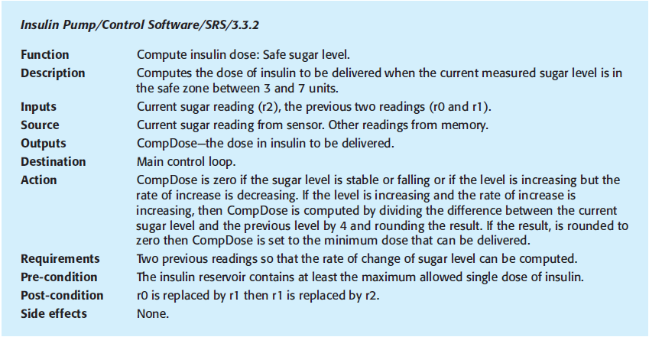
A structured specification of a requirement for an insulin pump

Slide 93
B-2) Tabular specification
Used to supplement natural language.
Particularly useful when you have to define a number of possible alternative courses of action.
For example, the insulin pump systems bases its computations on the rate of change of blood sugar level and the tabular specification explains how to calculate the insulin requirement for different scenarios.

Slide 94
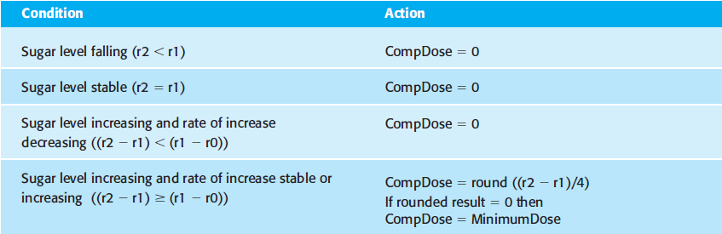
Tabular specification of computation for an insulin pump
Action
CompDose is zero if the sugar level is stable or falling or if the level is increasing but the rate of increase is decreasing. If the level is increasing and the rate of increase is increasing, then CompDose is computed by dividing the difference between the current sugar level and the previous level by 4 and rounding the result. If the result, is rounded to zero then CompDose is set to the minimum dose that can be delivered.

Slide 95
Scenario for collecting medical history in MHC-PMS

Slide 96
Scenario for collecting medical history in MHC-PMS

Slide 97
Use cases for the MHC-PMS

Slide 98
The structure of a requirements document
Chapter | Description
Preface | This should define expected readership of document and describe its version history, including a rationale for creation of a new version and a summary of changes made in each version.
Introduction | This should describe need for the system. It should briefly describe system’s functions and explain how it will work with other systems. It should also describe how system fits into the overall business or strategic objectives of organization commissioning software.
Glossary | This should define technical terms used in document. You should not make assumptions about experience or expertise of reader.
User requirements definition | Here, you describe services provided for user. Nonfunctional system requirements should also be described in this section. This description may use natural language, diagrams, or other notations that are understandable to customers. Product and process standards that must be followed should be specified.
System architecture | This chapter should present a high-level overview of anticipated system architecture, showing distribution of functions across system modules. Architectural components that are reused should be highlighted.

Slide 99
Requirements management planning
Establishes the level of requirements management detail that is required.
Requirements management decisions:
Requirements identification Each requirement must be uniquely identified so that it can be cross-referenced with other requirements.
A change management process This is the set of activities that assess impact and cost of changes.
Traceability policies These policies define relationships between each requirement and between requirements and system design that should be recorded.
Tool support Tools that may be used range from specialist requirements management systems to spreadsheets and simple database systems.

